Slide 1
Extending Rich Text Editor in Umbraco CMS
Wojciech Szubryt
wojciech.szubryt@intive.com
Wrocław, 22.02.2017

Slide 2
Agenda
TinyMCE
TinyMCE in Umbraco CMS
Custom plugin for RTE
Demo

Slide 3
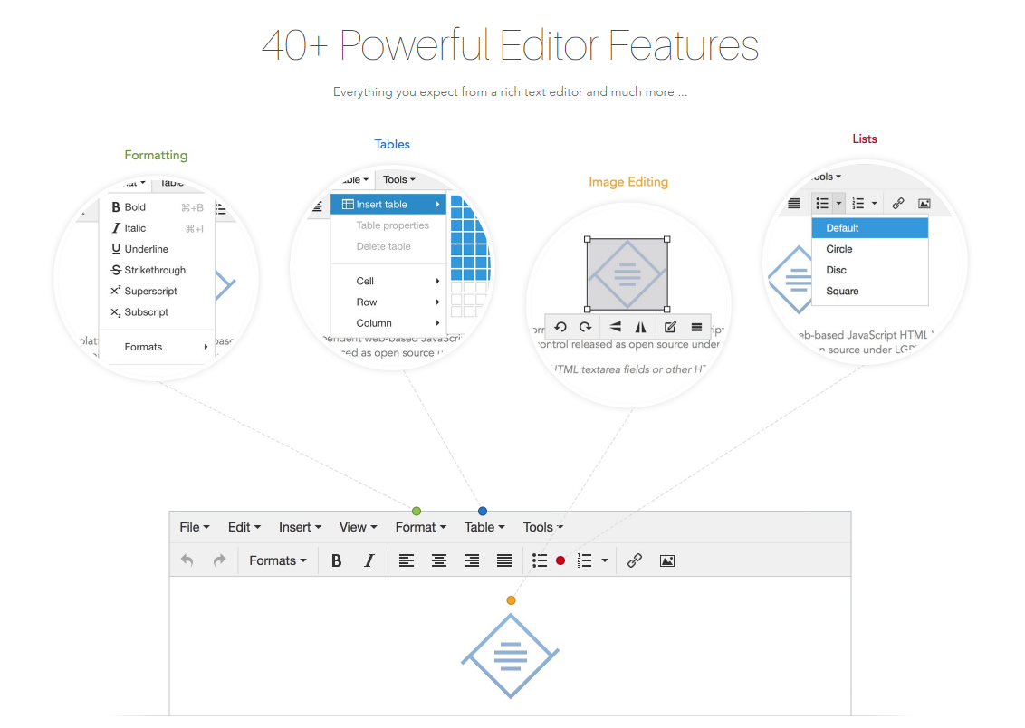
TinyMCE
Source: https://www.tinymce.com/features/

Slide 4
TinyMCE in Umbraco CMS
tinyMceConfig.config file
Be aware of Umbraco.PropertyEditors.RTEController parsing

Slide 5
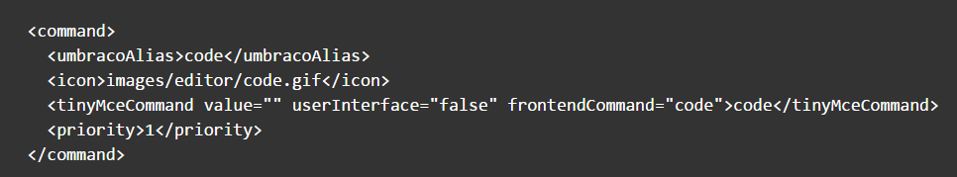
TinyMCE in Umbraco CMS – Commands
Source: https://our.umbraco.org/documentation/reference/config/tinymceconfig/

Slide 6
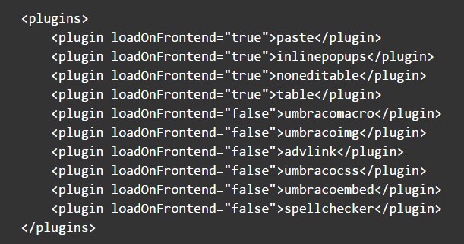
TinyMCE in Umbraco CMS – Plugins
Source: https://our.umbraco.org/documentation/reference/config/tinymceconfig/

Slide 7
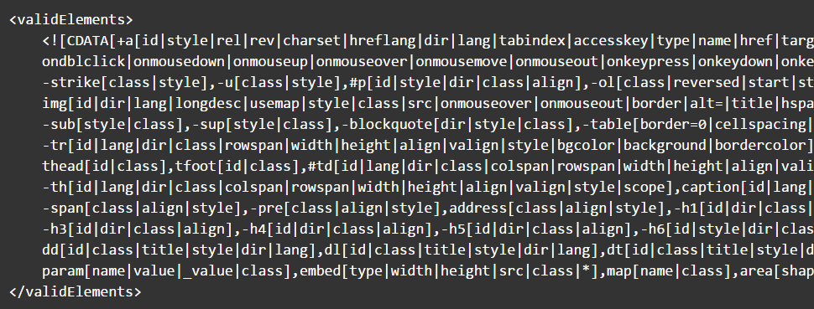
TinyMCE in Umbraco CMS – ValidElements
Source: https://our.umbraco.org/documentation/reference/config/tinymceconfig/

Slide 8
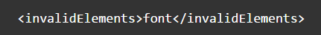
TinyMCE in Umbraco CMS – InvalidElements
Source: https://our.umbraco.org/documentation/reference/config/tinymceconfig/

Slide 9
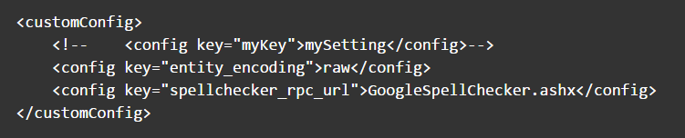
TinyMCE in Umbraco CMS – customConfig
Source: https://our.umbraco.org/documentation/reference/config/tinymceconfig/

Slide 10
TinyMCE in Umbraco CMS – Custom Plugin
Add plugin.min.js \Umbraco\lib\tinymce\plugins\pluginname
Register command
Register plugin
Enable plugins in Umbraco Grid settings

Slide 11
TinyMCE in Umbraco CMS – Custom Plugin
tinymce core class
create() method
Editor class
dom – DOM instance for the editor
selection – Selection instance for the editor
execCommand()
Selection class
getNode()

Slide 12
DEMO

Slide 13

Questions?

Slide 14
Thank You

